Slide 1
Software
Engineering
COMP2225
Session 5b: Software Development Process – Software Development Methodologies
Dr. Paul Walcott
Department of Computer Science, Mathematics and Physics
University of the West Indies, Cave Hill Campus
Barbados
NEXT

Slide 2
Session Objectives
On successful completion of this session a student will be able to:
  Describe five software development methodologies
  Compare and contrast software development methodologies and process models

Slide 3
Introduction
In this session the following five development methodologies will be described:
  Rational Unified Process
  Extreme Programming (XP)
  DSDM
  SCRUM
  EVO

Slide 4
Agile Methods
In the 1980s and early 1990s there was a widespread view that the best way to achieve better software was through
  Careful project planning
  Formalised quality assurance
  The use of analysis and design methods supported by CASE tools
  Controlled and rigorous software development

Slide 5
Agile Methods Contd.
This view came from software engineers who were developing large, long-lived software systems
When heavy weight, plan-based development approaches were applied to small and medium-size systems
  The overhead sometimes dominated the software development process

Slide 6
Agile Methods Contd.
More time was spent on how the system should be developed than on program development and testing
In the 1990s new agile methods were formulated which
  relied on an iterative approach
  allowed for changing requirements
  delivered software quickly to customers

Slide 7
Agile Methods Contd.
Agile methods such as extreme programming, Scrum, DSDM and the rational unified process share principles, such as:
  customer involvement;
  incremental delivery;
  a focus on people, not the process;
  embracing of change and maintaining simplicity; and,
  best suited for small or medium-sized systems

Slide 8
What are the root causes of software development problems?
Symptoms that characterise failed projects include:
  Inaccurate understanding of end-user needs
  Inability to deal with changing requirements
  Modules that do not fit together
  Software that is hard to maintain or extend
  Late discovery of serious project flaws
  Poor software quality
  Unacceptable software performance
  Untrustworthy build-and-release processes

Slide 9
What are the root causes of software development problems cont’d?
Many projects fail because there is
  Ad hoc requirements management
  Ambiguous and imprecise communication
  Brittle architectures
  Overwhelming complexity
  Undetected inconsistencies in requirements, designs and implementations
  Insufficient testing
  Subjective assessment of project status

Slide 10
What are some of the best practices?
Best practices to develop and maintain quality software include:
  Developing software iteratively
  Managing requirements
  The use of component-based architectures
  Visual modelling software
  Continuously verifying software quality
  Controlling changes to software

Slide 11
Rational Unified Process
(Kruchten, 2000)
The Rational Unified process (RUP) has two structures (dimensions)
  The horizontal axis, which represents time, shows the life cycle aspects of the process as it unfolds
  The vertical axis, which represents core process workflows, groups activities logically by nature

Slide 12
Rational Unified Process Contd.
The first dimension represents the dynamic aspect of the process as it is enacted
  this is expressed in terms of cycles, phases, iterations and milestones
The second dimension represents the static aspect of the process
  It describes process components, activities, workflows, artefacts and workers

Slide 13
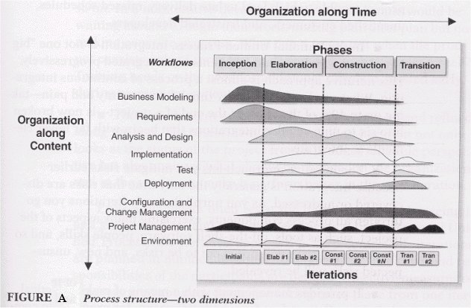
Rational Unified Process Contd.
(Kruchten, 2000, p.47)

Slide 14
Rational Unified Process Contd.
At inception the project scope is determined
During elaboration the problem is analysed, the project plan developed, risk assessed, and the software architecture described.
Application components are developed, integrated and tested during construction
At transition, the product is rolled out to the user.

Slide 15
Extreme Programming
This is probably the best known and most widely used agile method
In extreme programming (XP) all requirements are represented as scenarios (user stories)
  implemented as a series of tasks
Programmers work in pairs and develop tests for each task before writing code

Slide 16
Extreme Programming Contd.
All tests must be successfully executed when new code is integrated into the system
New versions of the software may be created several times a day
Increments are delivered to customers roughly every two weeks

Slide 17
Extreme Programming Contd.
Traditional software development suggests that you should design for change
XP discards this principle on the basis that anticipated changes often never materialise and is therefore wasted effort

Slide 18
Extreme Programming Contd.
Select user stories for this release
Breakdown stories into tasks
Plan release
Evaluate System
Release software
Develop/integrate/ test software
XP release cycle

Slide 19
Extreme Programming Contd.
XP practices include
  Incremental planning
  Small releases and simple design
  Test-first development and Refactoring
  Pair programming
  Collective ownership
  Continuous integration
  Suitable pace
  An on-site customer

Slide 20
Extreme Programming Contd.
In an XP process the customer is involved in specifying and prioritising requirements
The customer is part of the development team and discusses scenarios with the team

Slide 21
Extreme Programming Contd.
A story card is created which is broken down into tasks and implementation estimates determined
The customer prioritises the stories
The software is continually refactored

Slide 22
DSDM
The dynamic systems development method (DSDM) is a non-proprietary rapid application (RAD) development framework
It is owned, promoted and continuously updated by the DSDM consortium
DSDM is characterised by projects that are delivered on-time and to budget

Slide 23
DSDM
DSDM describes
  Project management
  Estimating
  Prototyping
  Time boxing
  Configuration management
  Testing
  Quality assurance
  Roles and responsibilities
  Team structures
  Tools environments
  Risk management
  Building for maintainability
  Reuse and vendor/supplier relationships

Slide 24
DSDM
DSDM is founded on the following basic principles
  Users must be actively involved in the process
  Each DSDM team must have the authority to make decisions
  Delivery of functionality must be frequent
  A deliverable is accepted on the basis of its fitness for the business purpose

Slide 25
DSDM
  Iterative and incremental development is required in order to converge on the correct business solution
  All development changes are reversible
  Requirements are base-lined at a high level
  Testing is done throughout the lifecycle
  Collaboration between the development team and stakeholders is essential
These principles are based on best practices

Slide 26
DSDM Lifecycle
At the start of the project a feasibility study and business study are done
    these determines suitability for DSDM
Three cycles of prototyping follow:
  Functional model Iteration
    the development of tested functional prototypes and supporting documentation
  Design and build Iteration
    development process completed by building in non-functional requirements

Slide 27
DSDM Lifecycle
  Implementation Iteration
    the system is rolled out into the business. This includes activities such as final acceptance testing, user documentation and project review
Several elements are put in place to control the development process including
  Time boxing
  Risk management
  Quality and testing principles
  Defined end products

Slide 28
DSDM
Requirements are prioritised using the MoSCoW rules
  Must Have, Should Have, Won’t have
The time for development is fixed (timebox)
Must have requirements are delivered first (in the time box) if there is a time issue
No particular development technique is mandated

Slide 29
SCRUM
The Scrum methodology is named after the scrum in rugby
SCRUM is an enhancement to the incremental process
Scrum treats large portions of the development process as a black box

Slide 30
SCRUM Contd.
Since requirements change, the software development process is unpredictable
SCRUM combines tools and techniques with a loose set of activities in order to build the system
Since there is a loose control of activities, risk management controls have been introduced

Slide 31
SCRUM Contd.
Scrum is characterised by:
  A start (planning and system architecture) process
  a sprint phase which comprises the develop, wrap, review and adjust activities
  An end (closure) process

Slide 32
SCRUM Contd.
Many of the processes in the sprint phase are unidentified and uncontrolled. Risk management is included to prevent chaos, yet allowing maximum flexibility
Sprints are flexible and non-linear. Any available knowledge is used; if no information is available then trial and error is used

Slide 33
SCRUM Contd.
The sprinting process results in the final product
Deliverables may be changed at any time during the planning and sprint phases

Slide 34
SCRUM Contd.
The Scrum development process is summarised in the following diagram
Wrap
Review
Develop
Planning and
system architecture
Closure
Adjust

Slide 35
SCRUM Contd.
In the planning phase
  risk are identified
  project teams assembled
  development tools selected
  cost estimation completed
  delivery date and functionality of one or more releases determined

Slide 36
SCRUM Contd.
In the system architecture phase, domain models are created which define the system context and requirements
In the sprint phase:
  Domain analysis, designing, developing, implementation, testing and documentation are completed during the develop activity
  An executable version of changes is produced during the wrap activity

Slide 37
SCRUM Contd.
  During the review activity work is reviewed by the teams and issues and problems resolved. Highlighted risks are also reviewed
  And during the adjust activity the information gathered in the review meeting is compiled

Slide 38
SCRUM Contd.
Finally, the closure phase is entered when management believes a new release should occur
  In this phase the product is integrated tested, system tested, user documentation and training material completed, as well as marketing material preparation

Slide 39
EVO
EVO is an evolutionary delivery methodology
It delivers a quality product on-time
It comprises of many short development cycles (typically one week in length)
Each cycle is a waterfall
Performs evaluation at the end of each cycle so it is done better next time around

Slide 40
EVO Contd.
Features to be delivered are in priority order
  most important requirements first
  highest risks first
  Features that educate users about the domain first
At the end of each cycle a complete, functioning product is produced

Slide 41
EVO Contd.
The metric(s) associated with each requirement determines whether the functionality has been completed
At the end of the project even if only 80% of the project is completed a working product, with the most important functionality is available

Slide 42
EVO Contd.
Comparatively, in the waterfall model if only 80% of the project is completed it is likely that the product will not work

Slide 43
Some software development methodologies / processes compared

Slide 44
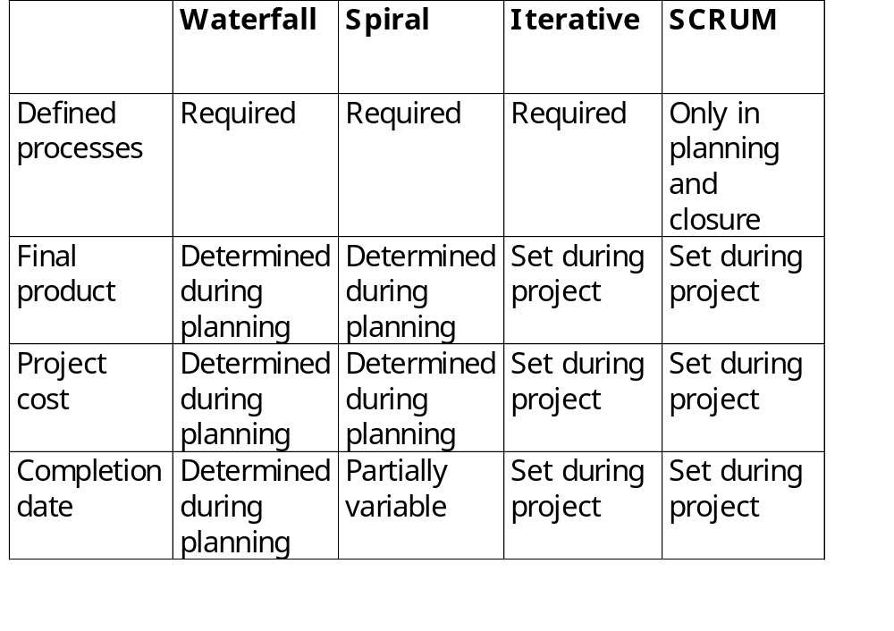

Slide 45
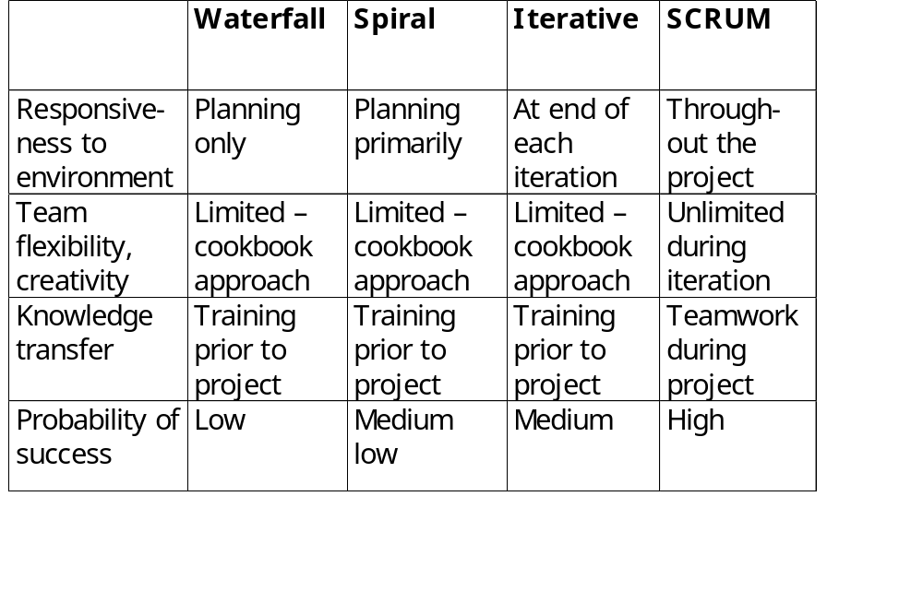

Slide 46
Use the Quiz for a Quick Recap
Do you want a quick recap? Why not use the quiz?
  Use either the immediate feedback version
    Provides a correct or incorrect message response after each question
  Or, the non-immediate feedback version

Slide 47
Heavy-weight, plan-based development approaches are best when creating small and medium-size systems.
Development Methodologies Quiz
Question 1
A
True
B
False
Peek
Click Peek to lookup the answer in the notes.
Skip

Slide 48
Which one of the following is not true about agile development approaches?
Development Methodologies Quiz
Question 2
A
Software can be delivered quickly to customers
B
These approaches are iterative
C
These approaches respond to the environment on a daily basis
D
These approaches allow customers to change requirements
Peek
Click Peek to lookup the answer in the notes.
Skip

Slide 49
This diagram represents which software development approach?
Development Methodologies Quiz
Question 3
A
XP
B
SCRUM
C
Waterfall
D
RUP
Peek
Click Peek to lookup the answer in the notes.
Skip

Slide 50
Which of the following features of XP allow for easy refactoring?
Development Methodologies Quiz
Question 4
A
Incremental planning
B
Test-first programming
C
Automatic unit testing
D
Continuous integration
Skip

Slide 51
Which one of the following is true about DSDM?
Development Methodologies Quiz
Question 5
A
Some development changes are not reversible
B
Delivery of functionality must be frequent
C
Testing is done at the beginning and end of the lifecycle
D
Only some DSDM teams have the authority to make decisions
Peek
Click Peek to lookup the answer in the notes.
Skip

Slide 52
The XP and DSDM methodologies can be used together.
Development Methodologies Quiz
Question 6
A
True
B
False
Peek
Click Peek to lookup the answer in the notes.
Skip

Slide 53
All processes in SCRUM are controlled.
Development Methodologies Quiz
Question 7
A
True
B
False
Peek
Click Peek to lookup the answer in the notes.
Skip

Slide 54
EVO delivers software faster than the Waterfall method.
Development Methodologies Quiz
Question 8
A
True
B
False
Skip

Slide 55
SCRUM has a higher probability of success that the spiral, iterative and waterfall models
Development Methodologies Quiz
Question 9
A
True
B
False
Peek
Click Peek to lookup the answer in the notes.
Skip

Slide 56
If you have a fixed cost project with changing requirements which development methodology is best?
Development Methodologies Quiz
Question 10
A
SCRUM
B
Waterfall
C
Spiral
D
Iterative
Skip

Slide 57
Congratulations
You have successfully completed the quiz
Click here to see your report card

Slide 58
Reflective Question
How do you determine which development methodology to use in an organisation?

Slide 59
Conclusions
In this session the reader:
  Learnt about the Scrum, XP, RUP, EVO and DSDM development approaches
  In addition, these approaches were compared

Slide 60
References
Sommerville, Ian. 2004. Software Engineering. 7th ed. USA: Addison Wesley
Kruchten, Philippe. 2000. The Rational Unified Process: An Introduction. 2nd ed. USA: Addison Wesley

